Slide 1
EMPLOYEE SALARY PREDICTION SYSTEM USING MACHINE LEARNING ALGORITHMS
CAPSTONE PROJECT
Presented By:
S Aruthra- Presidency University B.Tech. in Computer Science and Engineering AICTE Internship Student Registration ID : STU6820670882ad31746953992

Slide 2
OUTLINE
Problem Statement (Should not include solution)
System Development Approach (Technology Used)
Algorithm & Deployment (Step by Step Procedure)
Result
Conclusion
Future Scope(Optonal)
References

Slide 3
Problem Statement
Organizations often face challenges in determining fair and competitive salaries for employees due to the influence of various factors such as experience, education level, job role, location, and industry standards. Manual or traditional approaches to salary estimation can lead to inconsistencies, pay disparities, and employee dissatisfaction.
The goal of this project is to develop a data-driven Employee Salary Prediction System using machine learning techniques that can accurately predict an employee’s salary based on key features such as years of experience, education, job title, location, and skill set. This system aims to assist HR professionals in making fair compensation decisions and help job seekers understand their market worth.

Slide 4
System Approach
2. Libraries Required to Build the Model
pandas – For data loading, cleaning, and manipulation
numpy – For numerical and array-based operations
matplotlib – For creating visualizations and plots
seaborn – For enhanced statistical data visualizations
scikit-learn (sklearn) – For preprocessing, model training, evaluation, and metrics
shap (optional – for model explainability as an improvement) – To understand the impact of features on model predictions
joblib – For saving and loading trained models efficiently
1. System Requirements
A computer with:
Intel Core i5 processor or higher
Minimum 8 GB RAM
At least 500 MB of free storage
Operating System:
Windows 10 / Ubuntu / macOS
Software:
Jupyter Notebook or Google Colab
Python version 3.7 or higher

Slide 5
Algorithm Deployment
Import Necessary Libraries
Load libraries like pandas, numpy, seaborn, matplotlib, sklearn, etc.
Load the Dataset
Use pd.read_csv('adult 3.csv') to import the dataset into a DataFrame.
Explore and Preprocess the Data
Check for null values, duplicates, and inconsistent entries.
Handle missing values if any.
Convert categorical features using Label Encoding or One-Hot Encoding.
Normalize or scale numerical features if needed.
Feature Selection
Identify the most relevant features for predicting salary.
Drop unnecessary columns like IDs or non-informative features.
Split the Dataset
Use train_test_split() to divide the dataset into training and testing sets (e.g., 80% train, 20% test).

Slide 6
Model Building
Choose a classification model such as:
Logistic Regression
Decision Tree
Random Forest
Gradient Boosting, etc.
Train the model on the training data.
Model Evaluation
Evaluate model performance using metrics like:
Accuracy
Precision, Recall, F1-score
Confusion Matrix
Deployment - Google Colab and streamlit platform

Slide 7
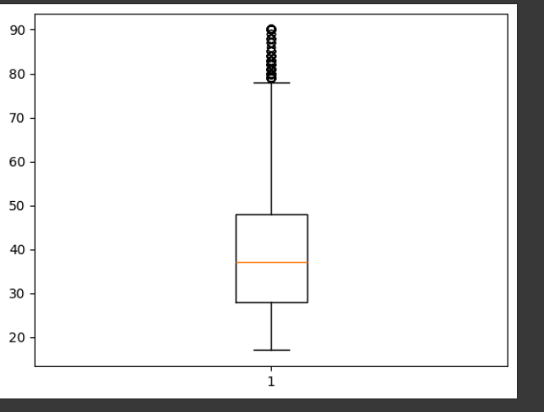
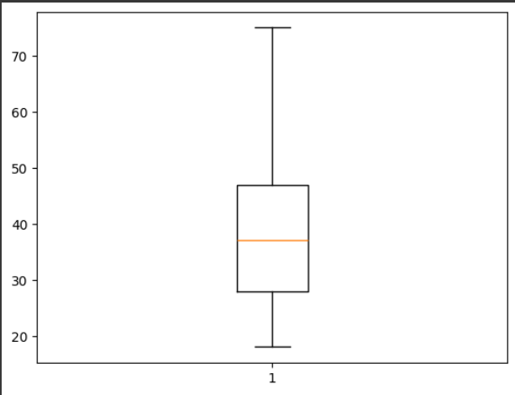
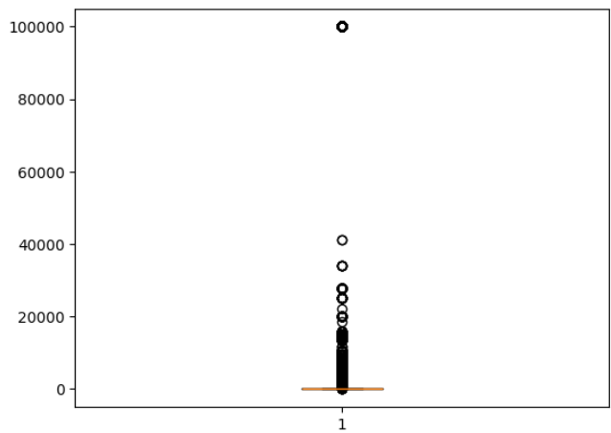
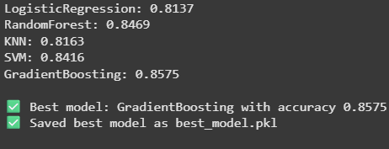
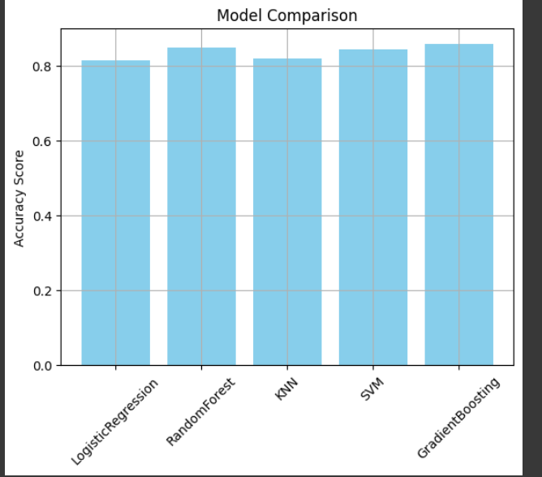
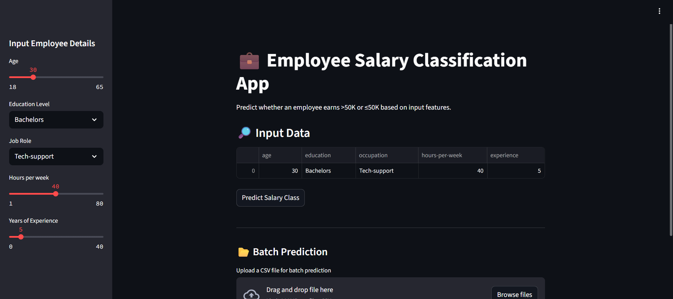
Result
https://github.com/saruthra/employee-salary-prediction-system-
Attach screen snaps of the code and output min 5
Attach your Github link
https://github.com/

Slide 8
Conclusion
In this project, we built a machine learning-based web application to predict whether an individual's income exceeds $50K annually using the UCI Adult Census Income dataset. We explored various classification models including Logistic Regression, K-Nearest Neighbors, Decision Tree, Support Vector Machine, Random Forest, Gradient Boosting, and Multi-layer Perceptron. Among them, ensemble methods such as Gradient Boosting and Random Forest achieved the best performance.
To improve usability and deployment, we implemented both Streamlit and Gradio interfaces, enabling real-time predictions from user input. Data preprocessing, such as handling categorical variables and scaling features, was key to ensuring model accuracy and consistency. Additionally, we performed detailed evaluation using classification reports and accuracy scores.
This project demonstrates how machine learning can provide valuable insights for HR analytics and decision-making, and it serves as a foundation for more advanced salary prediction systems that can incorporate real-time or more complex features in the future.

Slide 9
References
https://chatgpt.com/

Slide 10
THANK YOU

